Slide 2
Programs That Succeed
Building a Solid and Effective CTE Program
John Chevalier CTE Instructor / Apple Certified Trainer Sonoma County Office of Education Healdsburg High School
Educating for Careers Conference
Sacramento, California
March 2-4, 2014
© 2014 Chevalier Training
Notes:
Welcome:
My name, Position & School Name of Class If you’re in the wrong place it time to bail out.
Quick Survey of who we have with us: (You know who I am – I want to know who you are)
CTE Teachers, Core Subject Teachers, Administrators, Schools/Cities - what different backgrounds do we have here? AMWAY???
Class Objectives: In this session we will be talking Building a Solid and Effective CTE Program at your school. This is a program that is Solid in that both the curriculum is practical and at a current industry standard, as well as Effective in that students get as close to a real world experience as is possible in the high school setting.
My Experiences
Did not begin high school teaching until I was 45.
Prior to that I had been traveling and training leaders and teams for 10 years prior to that.
My first job in adult life was in the automotive industry, where I was a Honda/Acura Technician, Service Manager then the General Manager of an Auto Electric Specialty shop. During those years, from age 23 to 34, I’ve worked in non-profit corporations, spent 4 years with a major airline and was in the top 10% of sales after my first year with that company and ended up as an EAP representative. And then moved into public education.
When it comes to program development, I have developed individual workshops, entire educational tracks within existing conferences and have writing and developed entire seminars. I have always focused on personal growth and the growth of the organization that I’m working with.
When I came into education I thought I’d find a similar passion and drive and a commitment with educators to build great programs. I thought I’d find a clear mission for not only the programs but for entire organizations. I was sadly disappointed.
STORY: One day the executive director of our education foundation was singing my praises and telling me how awesome I was…. I had to stop her. Although I knew I was doing a good job, the accolades that I was getting were far too intense for what I was doing. That’s when I thanked her, but asked her not to judge my program based on what happens in public education, but what would happen at a public training facility. OK… Maybe I should be told “good job”, but the praise was too intense… She looked at me like I was from Mars, but came to be several days later and thanked me for the observation that everyone in education should be called to excellence in what we do.
That’s when I realized that the expectations for a high school program were so much lower than that in the professional training world. Excellence was not the standard… Instructors were going through the motions. This, I saw, as a HUGE problem.
We HAVE TO change this mentality. And, although I’ll admit, we may not ever be able to change the focus and drive or our schools, we do have complete control over what we do and what we can accomplish in our classrooms. And we need to be doing it. Learn to lead from the middle of the pack
So, I’m making an assumption here today… It’s that you chose to come to this class because you read the workshop description and not only want to start a CTE program, but you want to do it right. And if you are here because you want to improve your existing program, you came to the right place.
I want you to know that I consider myself a Trainer, more than a Teacher. I want you to be able to ask questions and for us to have a dialog here, however, I’m also aware that we have time considerations, so if possible I want to ask that you hold your questions to the end of each session, however, if you really need a clarification or have a question, please ask it.
Another thing you’ll notice is that I substitute the word TEAM in place of the word CLASS a lot. This is intentional because I’m building a mindset change in our program.
Finally I want to say a quick word about funding, because it’s listed in the class description. I have taught numerous workshops on program building and I get this question A LOT… “There do you get the funding for your program?” And when it’s asked I have watched almost the entire group get ready to take notes on what I’m about to say…
Now, I’m going to talk about creative funding at the end of the workshop, but I need to give you a general principle here and that is that; the quote “Give me the resources and I’ll build you a program” rarely is true in any industry and education is no exception. Yes, funding is important and we have to have it. But the lack of it is no excuse for not moving forward. The TRUTH is that money flows to good ideas, to growth, to vision and to commitment. You start to build a program with nothing and be successful and in time you will have the all the funding you need.
We’ll talk more about this….

Slide 3
Philosophy, Purpose & Mission
Program Philosophy
Know why you’re there.
How do you view your position?
Teacher or Leader?

Slide 4
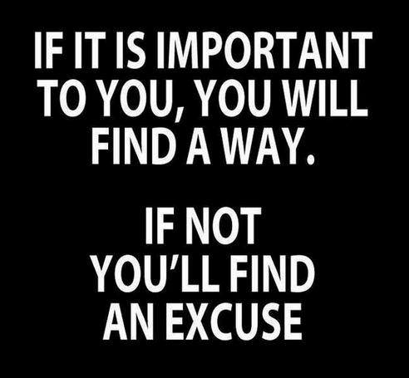
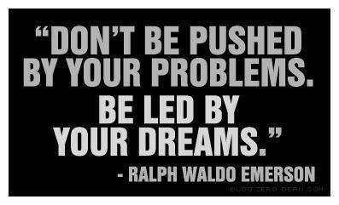
How do you view yourself as a Teacher?
Teacher = Leader
Positional Leadership
Leader = Teacher
Influential Leadership
NEW PARADIGM
Moving from being an instructor to being a mentor!

Slide 5
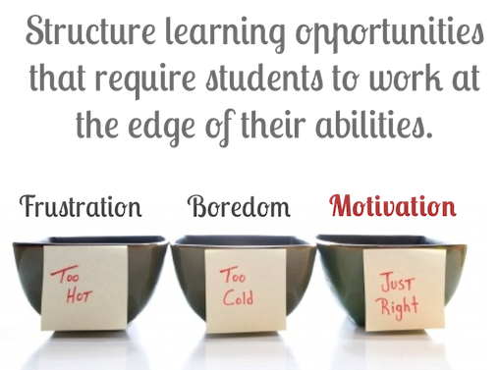
How do you view your Students?
The Problem:
MOTIVATION
Students are just not
motivated to Learn.

Slide 6
How do you view your Students?
The Reality:
NO CONNECTION
Students do not see a
Practical Connection between
the classroom and the real world.

Slide 7
How do you view your Students?
The Secret:
RELATIONSHIPS
Young people are motivated
by connection not by the
actual work in the classroom

Slide 8
How do you view your Students?
The Problem:
MOTIVATION
Students are just not motivated to Learn.
The Reality:
NO CONNECTION
Students do not see a practical connection
between the classroom and the real world.
The Secret:
RELATIONSHIPS
Young people are motivated by connection
not by the actual work in the classroom.

Slide 9
Philosophy, Purpose & Mission
Program Philosophy
Know why you’re there.
How do you view your position?
Teacher or Leader?
How do you view your duties?
Classroom or Program?
Know how you will function.
Instruction: Preparation
Hands On: Where the Learning takes place
Know where you are going.
Ready – Aim - Fire
Ready – Fire - Aim

Slide 10
Philosophy, Purpose & Mission
Know Your Purpose
What skills will you focus on?
- You cannot do it all
- Train in what you are good at : hard & soft skills
What product/service will you produce.
Beginning Level
- Skill Building – Paint a picture
- Create simple projects to give students exposure to all aspects of your discipline.
Advanced Level
- Create a “Real World” Experience
School video announcements, Auto
Services, Catering, etc…
- What can you offer?

Slide 11
Philosophy, Purpose & Mission
Program Mission Statement
Why do you need a Mission Statement?
Gives your team (classroom) a like mindset.
Provides Focus.
Lets your students know why you do what you do.
Things to consider.
What is YOUR mission?
What are YOU good at?
Where are YOUR successes?
What is the past strength of your program?
What is the Mission Statement of your school?

Slide 12
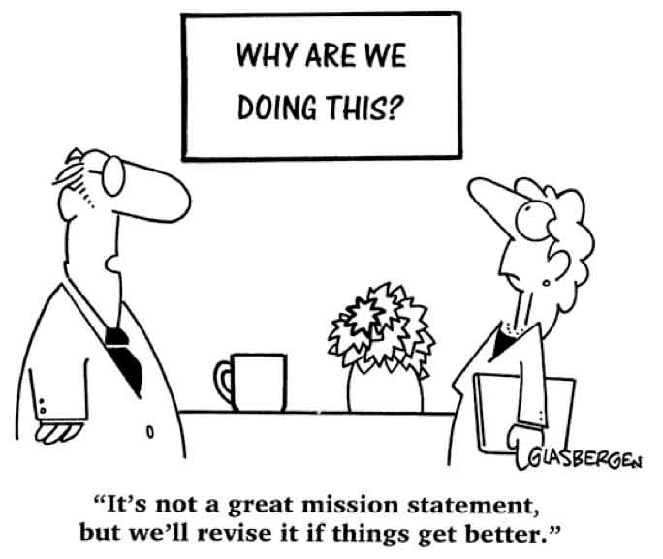
Mission Statement

Slide 13
Mission Statement
SCOE: Career Development/Workforce Preparation
To provide countywide leadership and support
for high school career education that is academically rigorous and aligned with the workforce preparation needs of our county.
Healdsburg High School
HHS supports the intellectual
and social growth of all students,
encouraging them and preparing them
to reach their full potential and to be contributing citizens in an ever changing world.

Slide 14
Mission Statement
Healdsburg Digital Video
To provide cutting edge and relevant education
in workforce preparation and digital video technology, utilizing the latest industry standard hardware
and software, in an environment that encourages learning, creativity, and personal growth.

Slide 15
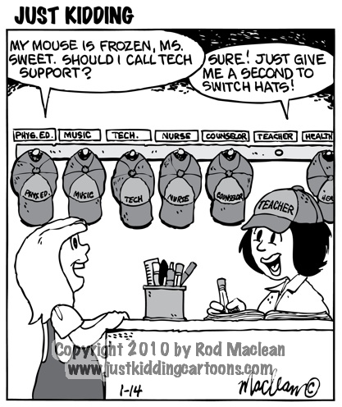
Structure & Function
Program Personnel
Teacher
Your role & responsibilities
Instructor:
Education Model
Program Director:
Employer Model
The reality is that you have to be both!!

Slide 16
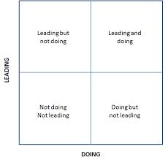
Structure & Function
Program Personnel
Students
The difference between Leaders and Doers
Create positions with
job descriptions
Leadership is earned
Commitment, Maturity, Teachable,
Responsible, Unity, Team Mentality

Slide 17
Structure & Function
The Classroom
Environment & Culture
Industry Relevant
Teach “State-Of-The-Art” Technology
Do you have a plan to keep your classroom up to date?
To teach it you have to learn it
Don’t be intimidated
The Community
Is the community a part of your classroom?
If not……. Why not????

Slide 18
Increasing Effectiveness
Communication is the key!
✔ Set Clear Written Classroom Guidelines.
Communicate Commitment.
Communicate Ongoing Expectations.
Relationships are important.
Teacher with Students
Students with each other
Encouragement is the most powerful tool you have.
LOTS OF IT!

Slide 19
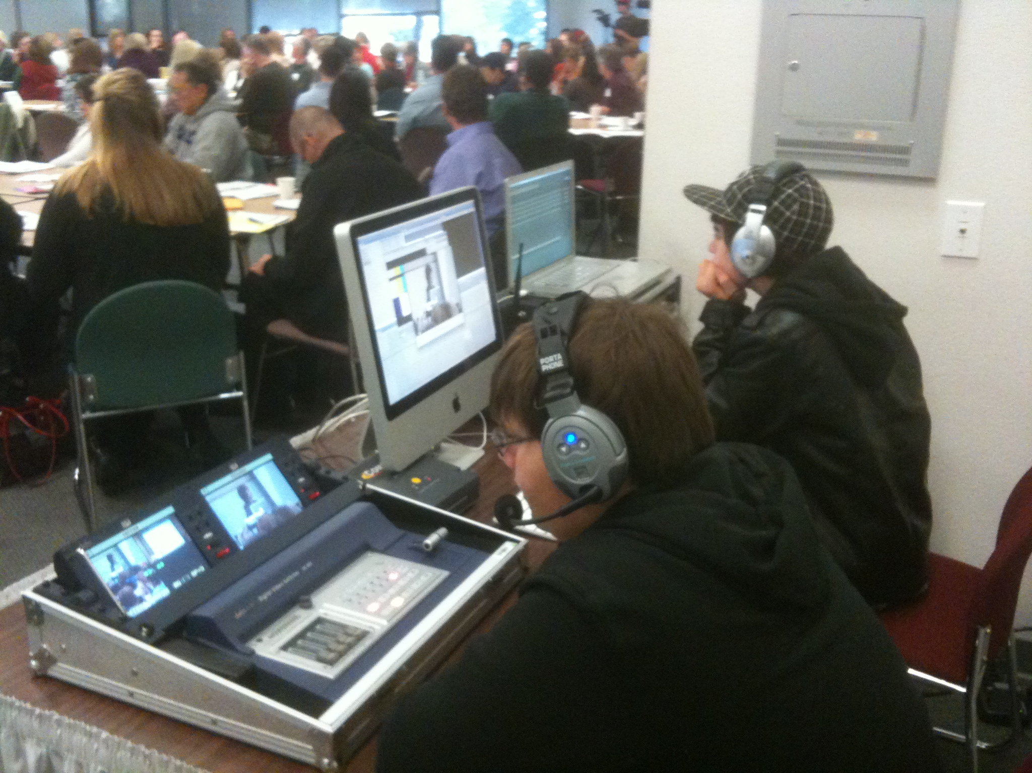
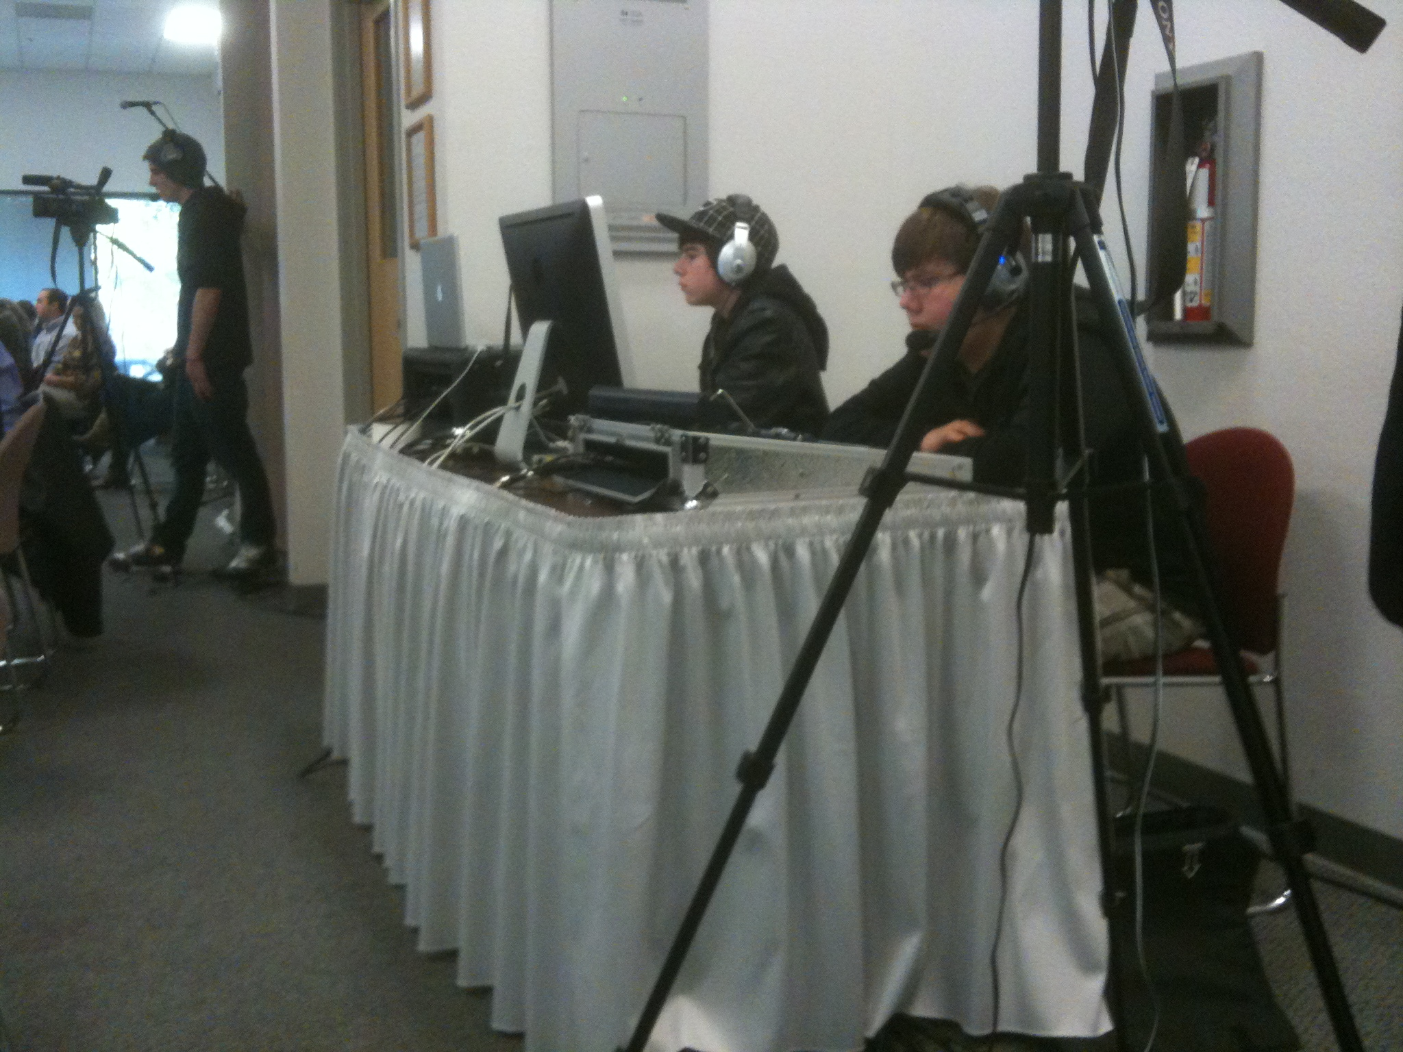
PR Your Program
Frequent Teaching & Public Recognition
✔ Emphasize the importance of quality work vs a grade.
A quality program will bring quality students.
Students want to be a part of something cool.

Slide 20
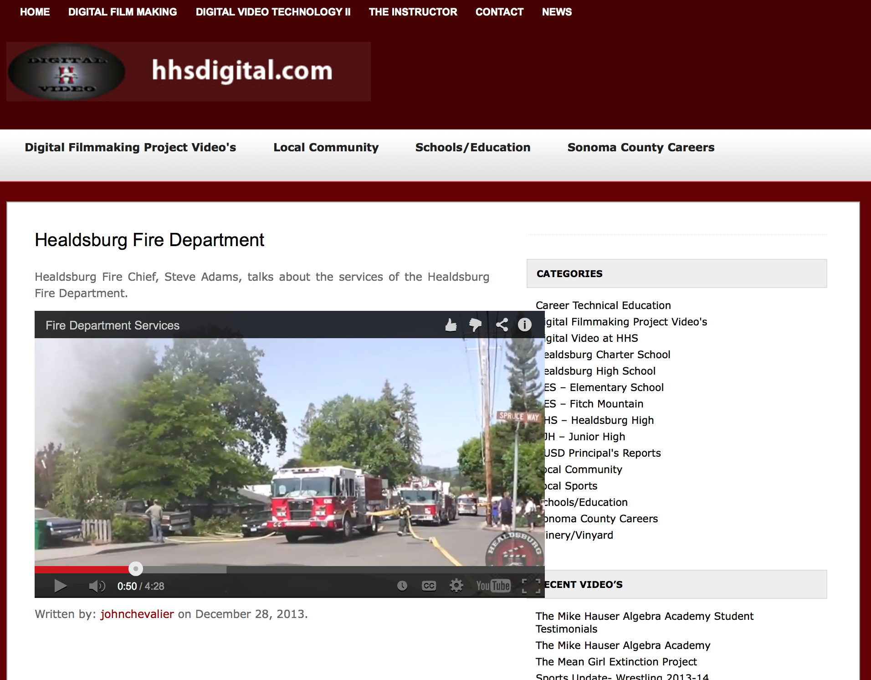
PR Your Program
Keep your Program Visible!!!!
✔ Facebook Page.
YouTube Channel.
Inviting businesses into your classroom.
Inviting local influencers into your classroom.

Slide 21
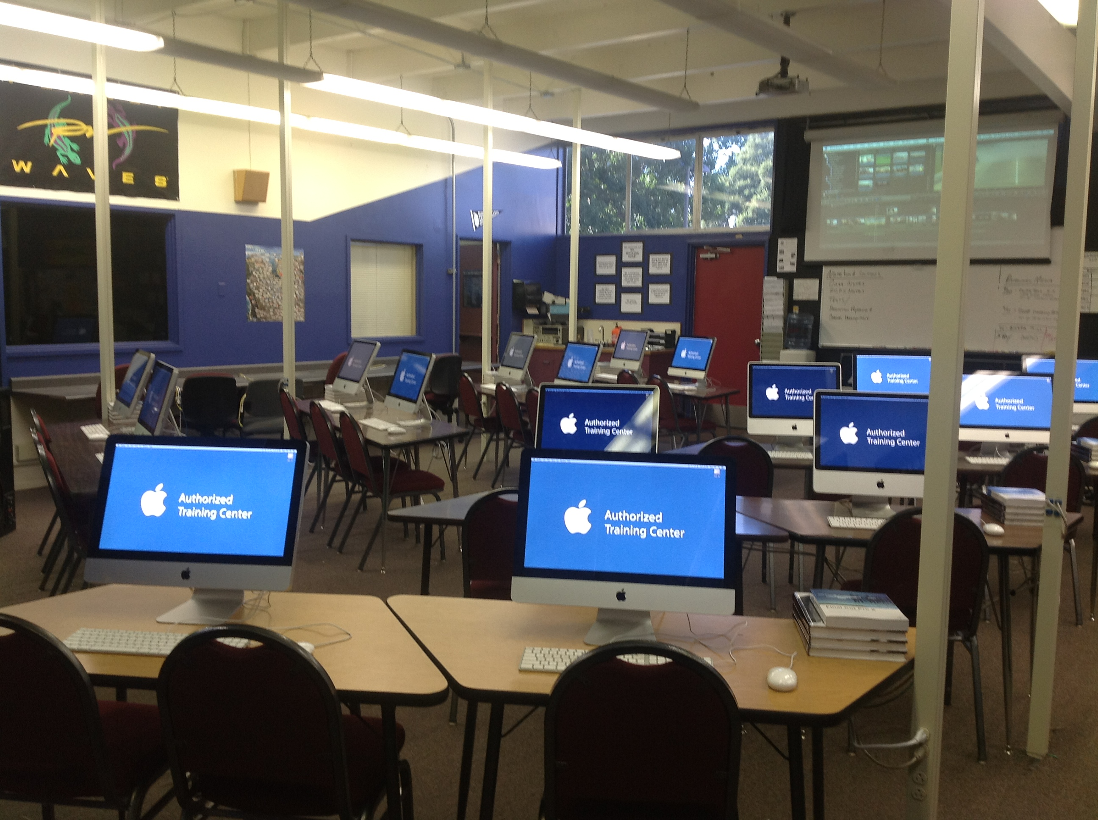
Funding Your Program
Where in the world to you get the money for all this????
Traditional Funding
Supply Budget
Equipment Budget
Training Budget
Thinking outside the box.
Partnerships
Donations
Provide a Service

Slide 22
Conclusion – Q & A

Slide 23
Contact Information
John Chevalier
CTE Instructor/Apple Certified Trainer
Sonoma County Office of Education Healdsburg High School
__________________________________________________________________
707-332-0838
jchevalier@scoe.org
http://www.johnchevalier.com

